Slide 1
March 4th
Diagnosis of ALS
Role of SOD1 in ALS
Axonal Transport in ALS
NMJ in ALS

Slide 2
Diagnosis of ALS
-No biological marker has been identified yet.
-Series of clinical and neurological exams
-MRI
-myelogram of cervical spine (an x-ray analysis that allows the detection of lesions in selected area of the spinal cord)
muscle and/or nerve biopsy
electromyography (EMG) and nerve conduction velocity (NCV), to measure muscle response to nervous stimulation.

Slide 3
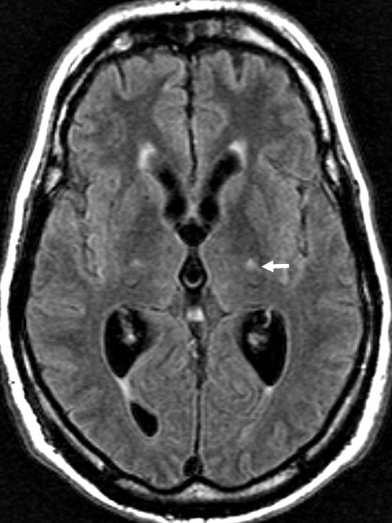
MRI in Amyotrophic Lateral Sclerosis (ALS)

Slide 4
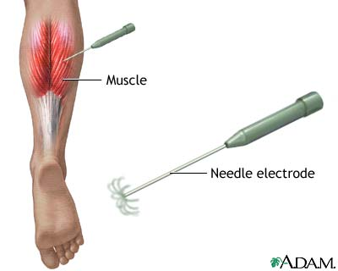
Electromyography (EMG)
A needle electrode is inserted through the skin into the muscle. Each muscle fiber that contracts will produce an action potential. The presence, size, and shape of the wave form of the action potential produced on the oscilloscope, provides information about the ability of the muscle to respond to nervous stimulation.

Slide 5
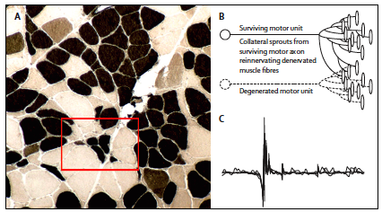
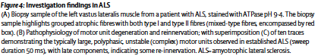
Atrophic muscle fibers in ALS patients

Slide 6
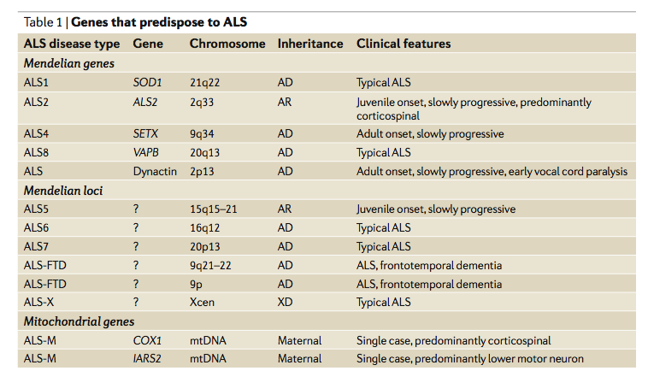
Genetic of ALS

Slide 7
Is ALS a mitochondrial disease?

Slide 8
Evidences of mitochondrial dysfunction in ALS:
-mitochondria aggregate in skeletal muscle and intramuscular nerve
-mitochondria show abnormalities in proximal axons and nerves of the anterior horn of spinal cord
-increased mitochondrial volume and calcium level
-dysfunction of mitochondrial complex I and IV
Decreased ATP production

Slide 9
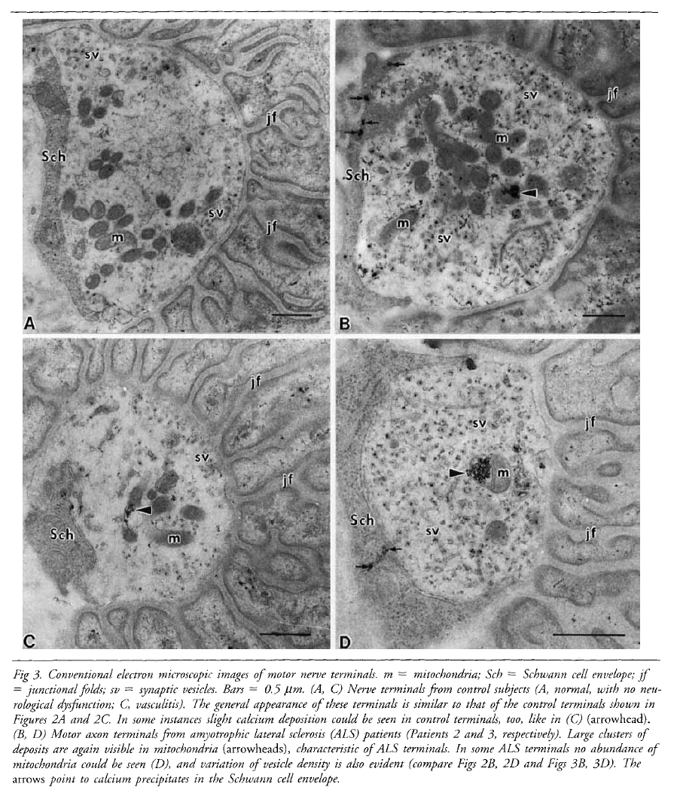
CONTROL
ALS
Calcium deposits in mitochondria of ALS patients
Syklos et al.,

Slide 10
Superoxide Dismutase 1 SOD1
SOD1 is a ubiquitous mostly cytosolic protein
SOD1 is comprised of 153 aa with an approximate molecular weight of 16kDa and is an active homodimer
Each of the two dimers of SOD1 binds a Cu⁺⁺ and a Zn⁺⁺ ion. The reduction of Cu⁺⁺ to Cu⁺ is behind the mechanism of SOD1 in regulating the dismutation of superoxide ion O₂^{-.} into hydrogen peroxide H₂O₂
Cu²⁺ + O^{2-·} Cu⁺ + O₂
Cu⁺ + O^{2-·} + 2H⁺ Cu²⁺ + H₂O₂
2 O^{2-·} + 2H⁺ H₂O₂ + O₂
A catalase will subsequently reduce hydrogen peroxide to water.

Slide 11
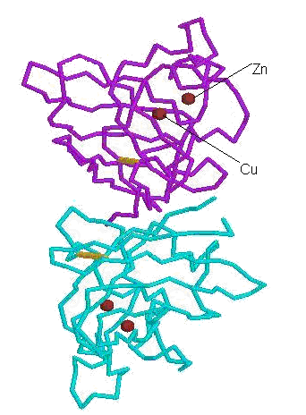
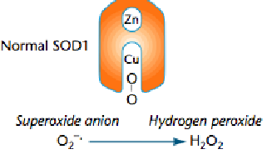
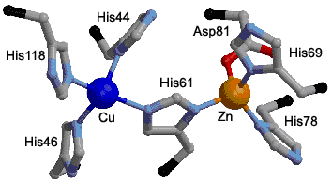
SOD1 structure: the functional homodimer

Slide 12
Most common mutations in SOD1 related FALS

Slide 13
SOD1 and FALS
-More than 125 mutations have been found on the SOD1 gene, 114 are related to ALS, most of them are missense mutations, only 12 are nonsense mutations or deletion mutants.
-Most mutations reduce dismutation activity, however others retain full dismutase activity, still are related to the disease. Moreover, there is NO CLEAR CORRELATION between enzyme activity and progression of the disease.
-In addition, in animal models, gene KO for SOD1 does not cause motorneuron disease, whereas overexpression of SOD1 does.
In this respect, the simple manipulation of SOD1 dismutase activity IS NOT necessarily behind ALS/motorneuron disease.

Slide 14
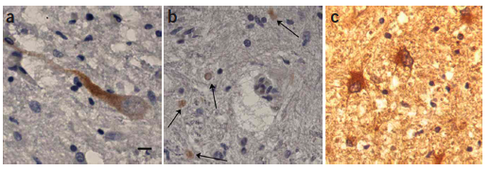
SOD1 misfolds and aggregates in FALS SOD1A4V motorneurons
SEDI Ab
SEDI-reactive SOD1
SOD1

Slide 15
Possible roles of mutant SOD1 in FALS
Loss of physiological function: impaired dismutase activity
Gain of toxic function:
1) Aberrant redox chemistry, probably due to changes in the conformation of SOD1, that leave the channel (the portion of the molecule accepting superoxide ion, i.e.) able to accept larger molecules. This can lead to peroxidation, tyrosine nitrosylation and reverse catalysis (due to improper binding of Zn⁺⁺ to the molecule that leads to formation of superoxide ion rather than dismutase activity). These activities are not a characteristic of ALL SOD1 mutations, thus remain partially controversial.
2) Protein instability and SOD1 aggregation. These activities are characteristic of all SOD1 mutants.

Slide 16
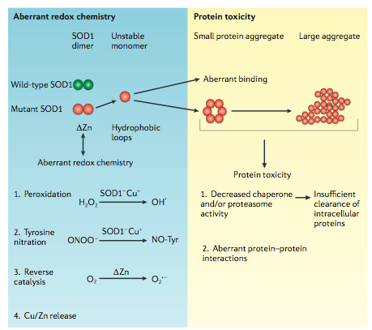
Models of mutant SOD1-mediated toxicity

Slide 17
How SOD1 aggregates could be toxic?
Mitochondrial dysfunction and apoptosis
Studies in FALS

Slide 18
SOD1 aggregates trigger apoptosis by inhibiting BCL-2, a mitochondrial anti-apoptotic protein

Slide 19
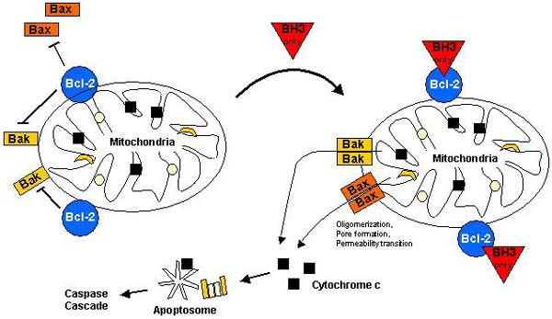
BCL2 in apoptosis
Notes:
Regulation of apoptosis by the Bcl-2 family. In a viable cell, the proapoptotic Bcl-2 family members Bax, Bak, and BH3-only proteins are antagonized by antiapoptotic members such as Bcl-2. In response to an apoptotic stimulus, BH3-only members are activated by transcriptional upregulation (Bax, Noxa, Puma), subcellular relocalization (Bim, Bmf), dephosphorylation (Bad), or proteolysis (Bid). Activated BH3-only proteins prevent antiapoptotic Bcl-2 members from inhibiting proapoptotic members. In addition, they might directly induce a conformational change of Bax and Bak which subsequently oligomerize and insert into the mitochondrial membrane where they form pores either by themselves or by associating with the permeability transition pore complex. In consequence, proapoptotic factors are released from the inner mitochondrial membrane into the cytosol, such as cytochrome c which contributes to the formation of the apoptosome and the subsequent activation of the caspase cascade.

Slide 20
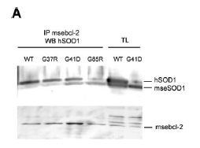
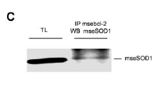
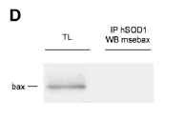
SOD1 associates with Bcl2, but not with Bax, in vitro…
Exogenous SOD1
Endogenous SOD1

Slide 21
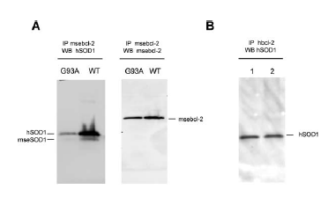
…and in vivo
mice
Human spinal cord

Slide 22
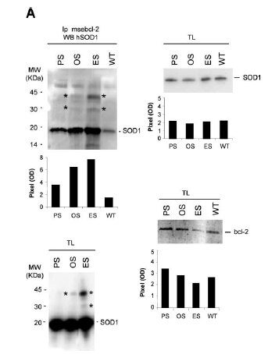
Bcl2 binds aggregated SOD1 in animal models of ALS…

Slide 23
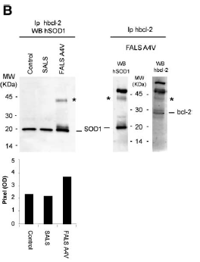
…and in spinal cord of ALS patients FALS SOD1 A4V

Slide 24
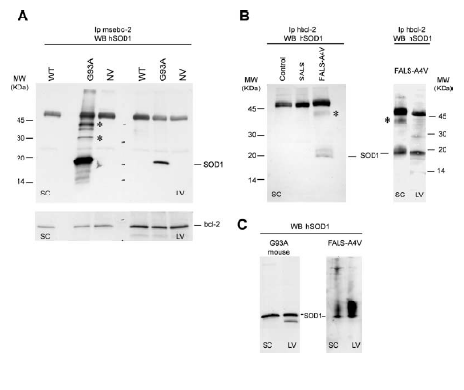
Mutant SOD1 binds Bcl2 specifically in mitochondria of the Spinal Cord
ALS patients
Animal models

Slide 25
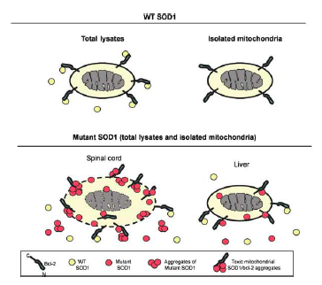
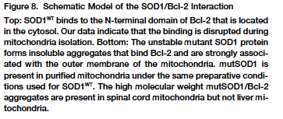
SOD1 aggregates recruit Bcl2 and start apoptosis in FALS

Slide 26
Toxic mechanisms of SOD1 in mitochondria
INSIDE THE MITOCHONDRIA
*forming aggregates
*interfering with cytochrome c in the peroxisomes (fusion of the peroxisomes membranes, formation of pores and release of cytochrome c, initiation of apoptosis)
OUTSIDE THE MITOCHONDRIA
*forming aggregates in the outer membrane, this leads to disruption of TOM (Translocator Outer Membrane complex) disruption of protein transport in the mitochondrion.
*forming aggregates with anti-apoptotic Bcl2 at the surface of the mitochondria, thus leading to apoptosis

Slide 27
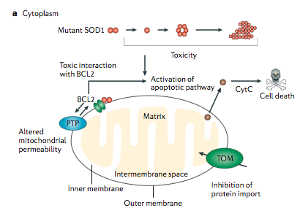
The mitochondrion as a target of mutant SOD1

Slide 28
How could mutant SOD1 be related to mitochondrial defects?
Altering mitochondrial structure, causing formation of vacuoles and ultimately rupture of the mitochondrial outer membrane leading to apoptosis
Is SOD1 in sporadic ALS toxic through the same mechanisms?

Slide 29
Evidences that SOD1 could be involved also in SALS
-Symptoms and pathology of SALS patients are the same as in SOD1 related FALS patients
-Pathologic alterations of SOD1 mutant mice are similar to those observed in SALS patients
Formation of mitochondrial vacuoles
Expansion and rupture of the mitochondrial outer membrane
Alterations of calcium homeostasis in the mitochondria
Alterations of mitochondrial membrane potential
Formation of calcium deposits within the mitochondria

Slide 30
1-SOD1 could be modified in SALS
2-SALS and FALS may share the same toxic mechanism of toxicity of SOD1

Slide 31
Can SOD1 form aggregates also in SALS?

Slide 32
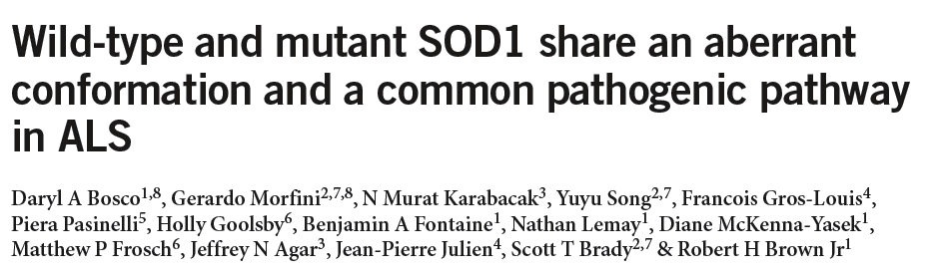

Slide 33
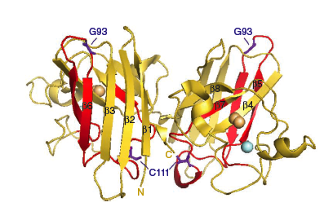
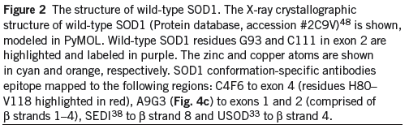
SOD1 conformation-specific antibody

Slide 34
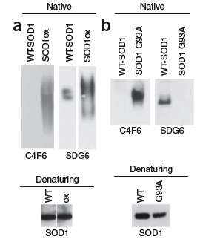
Conformation-specific SOD1 antibody detects
oxSOD1 in non-denaturing conditions

Slide 35
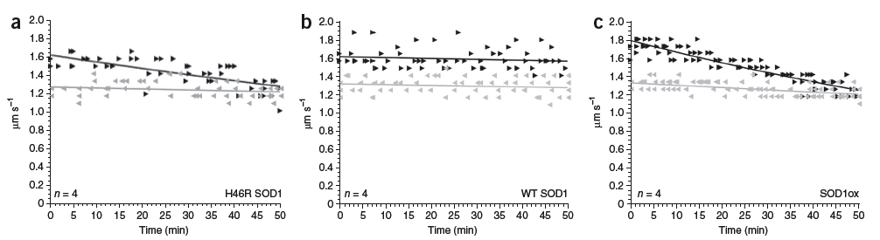
SOD1 oxidation inhibits anterograde Fast Axonal Transport FAT

Slide 36
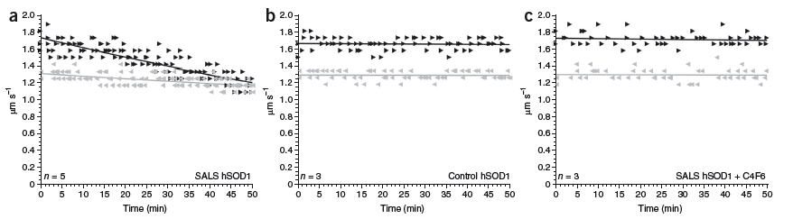
Sequestration of conformation-specific oxSOD1 reverts the effects of wtSOD1 on FAT in SALS

Slide 37
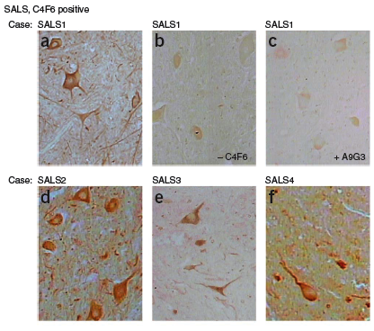
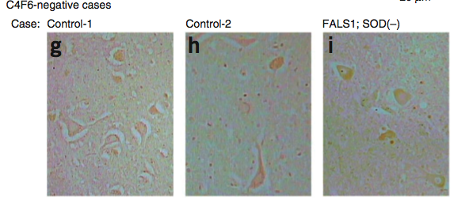
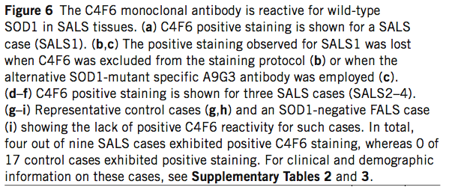
Conformation-specific SOD1 antibody reacts with wtSOD1
only in SALS

Slide 38
Mitochondrial abnormalities and dysfunction both in FALS and SALS
A cause or a consequence?

Slide 39
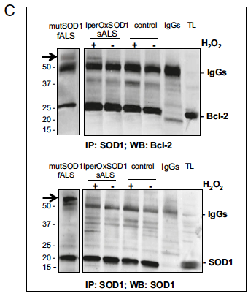
Hyperoxidized SOD1 forms a complex with Bcl2…

Slide 40
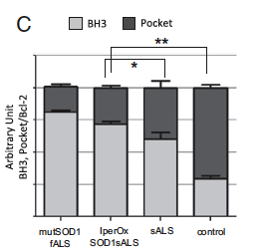
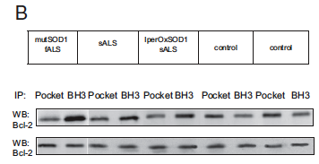
Bcl2 is conformationally modified in lymphoblasts of hyperoxidized SOD1 ALS and in fALS

Slide 41
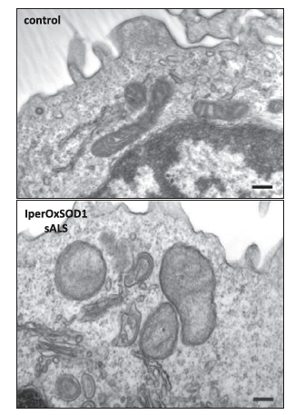
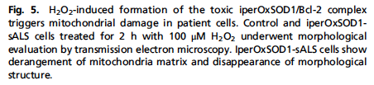
Hyper-oxidized SOD1 can be associated with
mitochondrial dysfunction

Slide 42
Axonal transport: Intracellular transport in neurons
-Neurons are polarized cells. The presence of a positive or negative pole provides driving force to regulate anterograde or retrograde transport.
-Anterograde: from cell body to neuronal end. Positive pole.
-Retrograde: from neuronal end back to cell body. Negative pole.
What is transported?
Proteins (synthesized in the cell body)
Organelles-Mitochondria
Vesicles

Slide 43
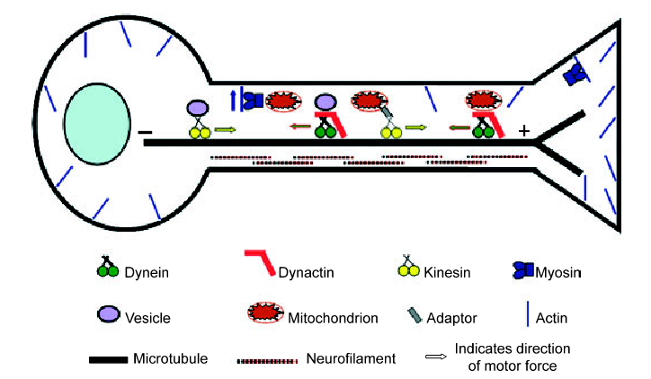
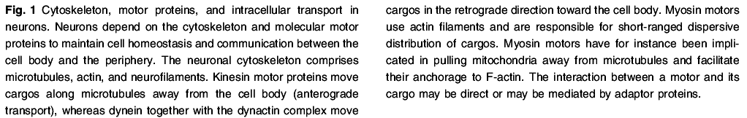
Axonal Transport

Slide 44
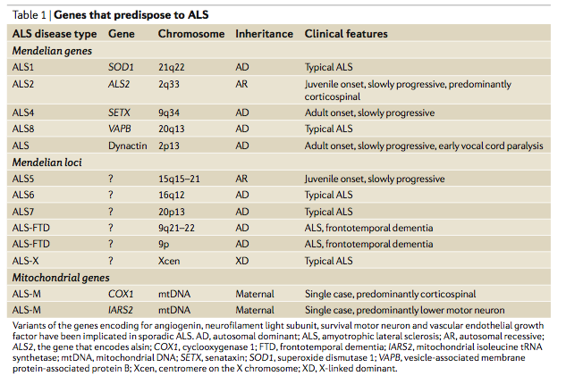
Point mutations in the gene of dynactin are associated to FALS

Slide 45
ALS and axonal transport
In motorneurons, axons are very long thus both anterograde and retrograde transport are complex events
Neuronal transport is reduced in ALS
SOD1 aggregates
Deposition of neurofilament
Defects and mutations in dynactin

Slide 46
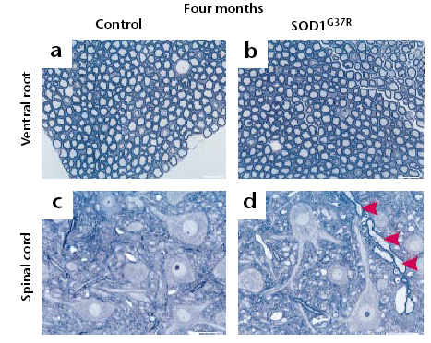
Axonal vacuolation is an early event that precedes neurodegeneration in a model of ALS

Slide 47
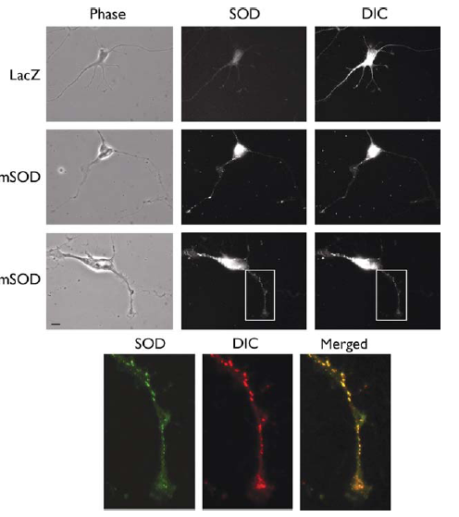
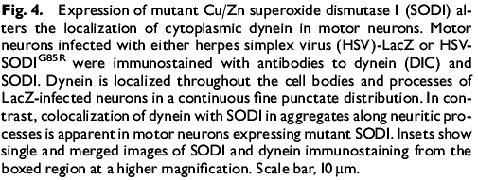
Aggregates of G85RSOD1 are found in the axons, co-localizing
with dynein: possible role of mutant SOD1
in damaging axonal transport
Neuroreport

Slide 48
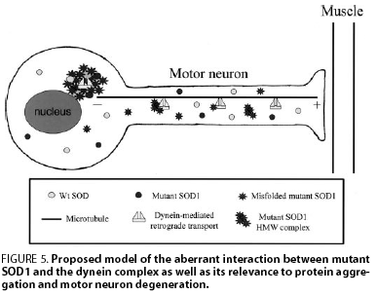
Model of aberrant interaction between
SOD1 aggregates and dynein on FALS

